Slide 1

Chapter 1
Introduction to web development
Notes:
Session: Ghi số thứ tự session trong môn học
Session Name: ghi tên của session sẽ dạy

Slide 2
Objectives
How web application work
An introduction to HTML and CSS
Tools for web development
How to view deployed web pages
Five critical web development issues
Notes:
Mô tả nội dung mà học viên phải đạt được khi kết thúc môn học này

Slide 3
How web application work?
Notes:
Session: Ghi số thứ tự session trong môn học
Session Name: ghi tên của session sẽ dạy

Slide 4
Definitions
World Wide Web (Web)
WWW consist of all the public Websites connected to the Internet worldwide, including the client devices that access Web content.
The WWW is just one of many applications of the Internet and computer networks.
2. Web Application
Web Application includes Client and Server
Clients are the computer, tablets and mobiles devices that use the web applications.
Web server holds the files that make up a web applications.

Slide 5
Definitions (cont)
Network
LAN: Local Area Network
WAN: Wide Area Network
ISP: Internet Service Provider
IXP: Internet Exchange Points
IP: Internet Protocol

Slide 6
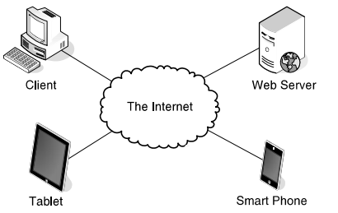
Components of Web application

Slide 7
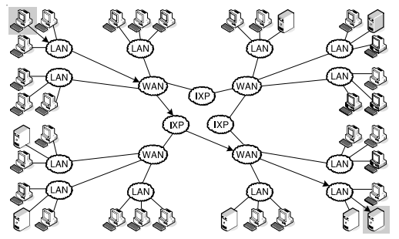
The architect of the Internet

Slide 8
Web Page
Web page is a page content display on web browser
Web page include
Static web page
Dynamic web page

Slide 9
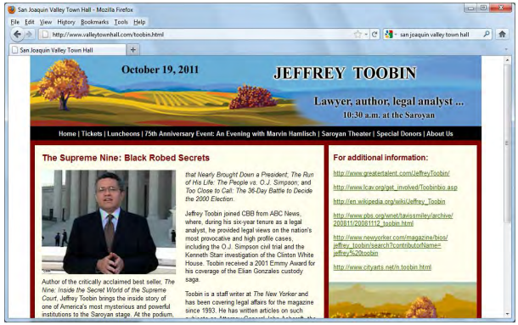
A web page
A static web page

Slide 10
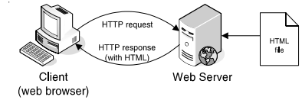
Static web pages are processed

Slide 11
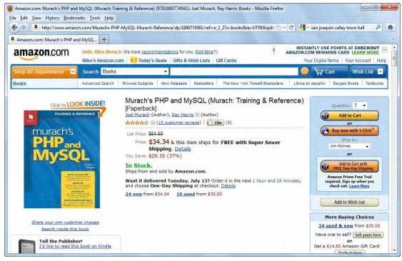
Dynamic web pages are processed
A dynamic web page is a web page that’s generated by a server – side program or script.
A dynamic web page at amazon.com

Slide 12
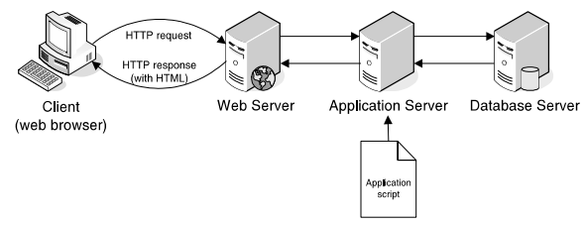
Web server processes a dynamic web page

Slide 13
An introduction to HTML and CSS
Notes:
Session: Ghi số thứ tự session trong môn học
Session Name: ghi tên của session sẽ dạy

Slide 14
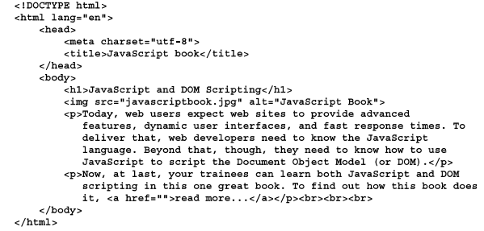
An Introduction to HTML
HTML (Hypertext Markup Language) is used to define the structure and content of a web page

Slide 15
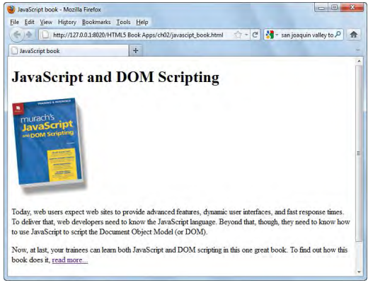
A web page

Slide 16
An Introduction to CSS
Cascading Style Sheets (CSS) are used to control how web pages are displayed by specifying the fonts, colors, borders, spacing, and layout of the pages.
The element in the head section of the HTML file that links it to the CSS file:
<link rel=“stylesheet” href=“book.css”>

Slide 17
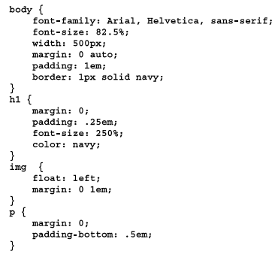
CSS Sample

Slide 18
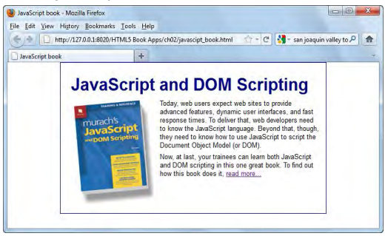
Web page using CSS

Slide 19
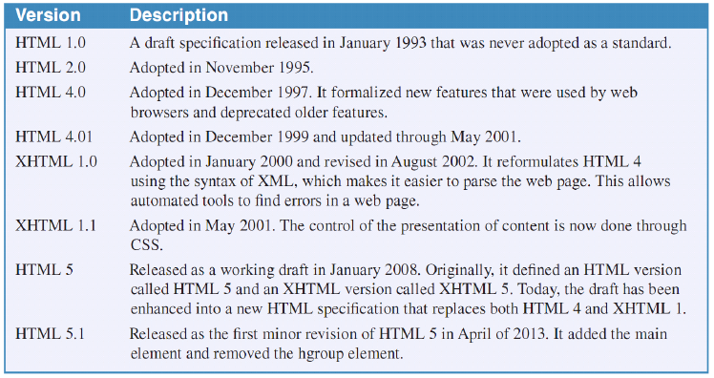
Highlights in the development of the HTML standards

Slide 20
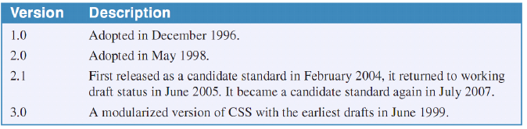
Highlights in the development of the CSS standards

Slide 21
Tools for web development
Notes:
Session: Ghi số thứ tự session trong môn học
Session Name: ghi tên của session sẽ dạy

Slide 22
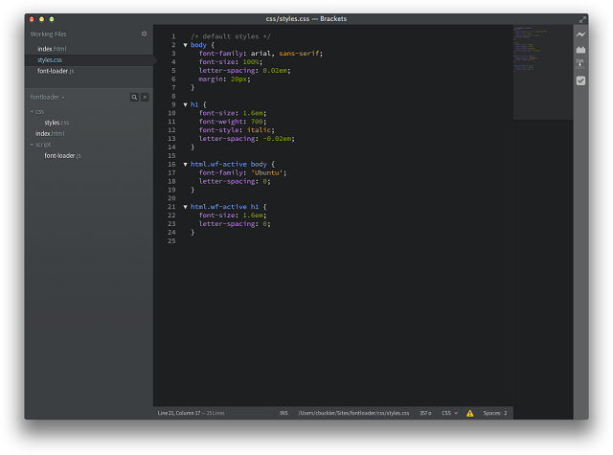
Text editors for HTML and CSS
A text editor lets you enter and edit the HTML and CSS files for a web application.
Introduction Brackets text editor

Slide 23
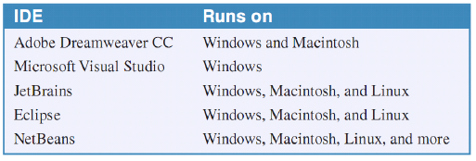
IDEs for web development
An Integrated Development Environment (IDE) goes beyond text editing to provide other features for the development of web site
Popular IDEs for web development

Slide 24
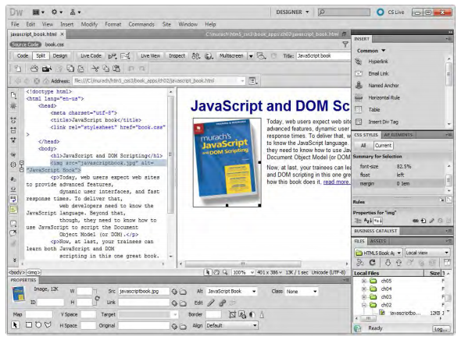
IDEs for web development (Cont..)

Slide 25
FTP programs for uploading files to the web server
To deploy a web site on the Internet, you need to transfer the folders and files for the web site from your computer or network to a web server on the Internet. To do that, You use an FTP program that uses File Transfer Protocol.
FileZilla as it is used to upload files to the web server

Slide 26
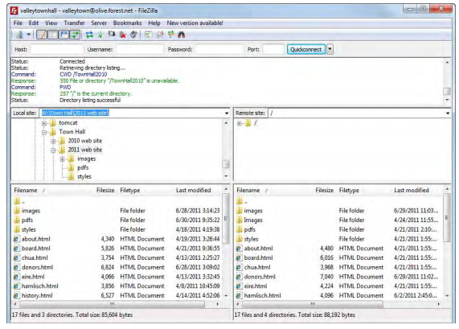
Filezilla program

Slide 27
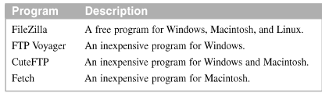
Some popular FTP programs

Slide 28
How to view deployed web page
Notes:
Session: Ghi số thứ tự session trong môn học
Session Name: ghi tên của session sẽ dạy

Slide 29
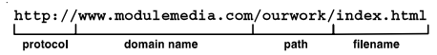
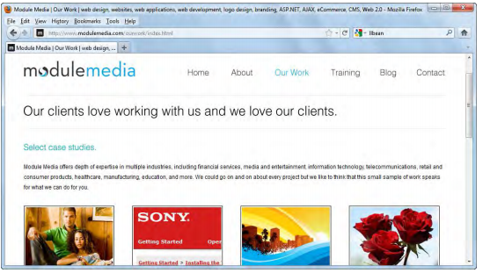
View a web page
The components of a HTTP URL
- The web page at

Slide 30
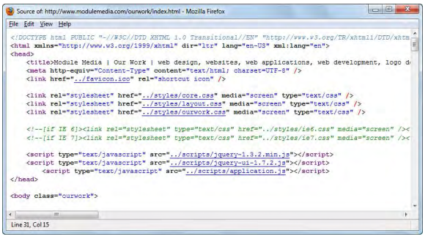
view the source code for a web page
When you view the source code for a web page in a web browser, the HTML code is open in a separate window.

Slide 31
Five critical web development issues
User and Usability
Usability refers to how easy it is to use a web site, and usability is a critical requirement for an effective web site
What website users want
How web site users use a web page

Slide 32
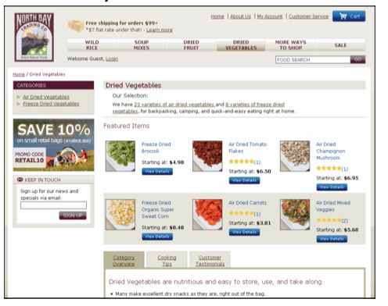
A website that is easy to use

Slide 33
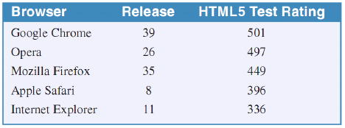
Five critical web development issues
2. Cross-browser compatibility
As a web developer you want your web pages to work on as many different web browser as possible. This is referred to as cross-browser compatibility.
The current browser and their HTML5 ratings

Slide 34
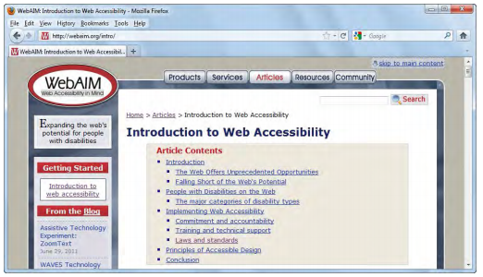
Five critical web development issues (cont.)
3. User accessibility
- Accessibility refers to the qualities that make a website accessible to user, especially disabled users.
The Articles tab of the WebAIM site

Slide 35
Five critical web development issues (cont.)
4. Search engine optimization
Search engine optimization (SEO) refers to the goal of optimizing your web site so its page will rank high in the search engines that are to access them.
The most popular search engines
Google, Yahoo, Bing
The Google search results for “HTML5 documentation”

Slide 36
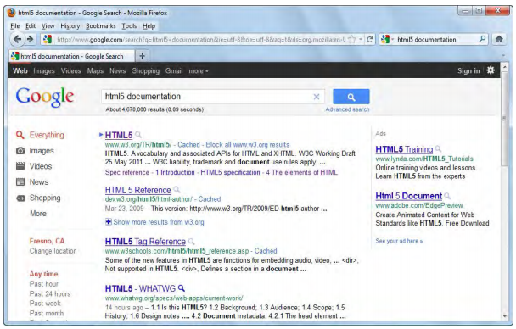
Five critical web development issues (cont.)

Slide 37
Five critical web development issues (cont.)
5. Responsive Web Design
Responsive Web Design refers to websites that are designed to adapt gracefully to the screen size.
Media queries, scalable images and flexible layouts are the backbone of Responsive Web Design

Slide 38
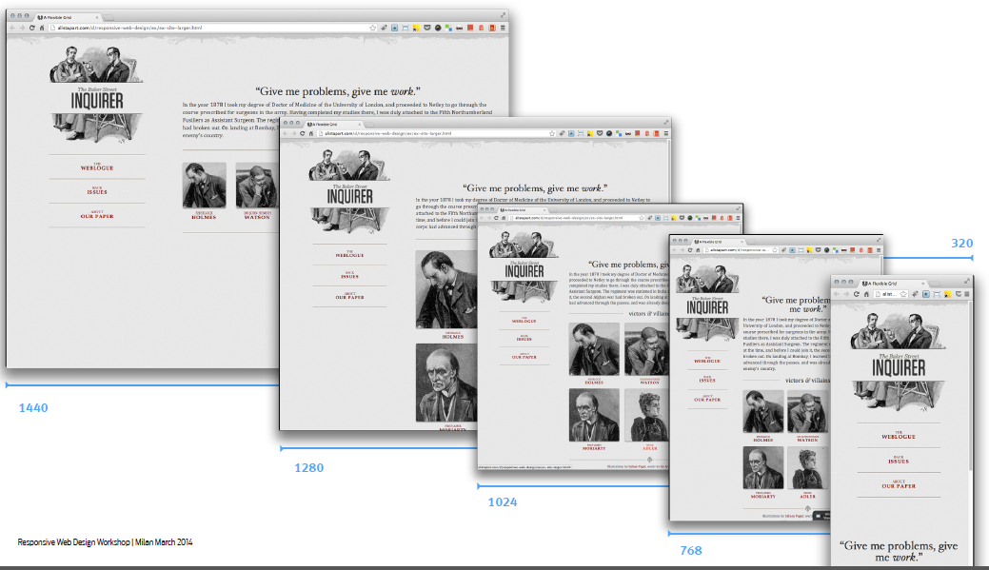
Responsive Design

Slide 39
Summary
Web application consist of client , a web server and network
A local area network (LAN) and a wide area network (WAN)
HTTP request and HTTP response
A static web page and dynamic web page
JavaScript engine of a web browser
Hypertext Markup Language and Cascading style sheets
IDE (Integrated Development Environment) and FTP (Files Transfer Protocol)
URL (Uniform Resource Locator)
Cross browser compatibility
Notes:
Tóm tắt lại nội dung đã học

